Slide 1
Weekly Progress
Maurice - Week 2

Slide 2
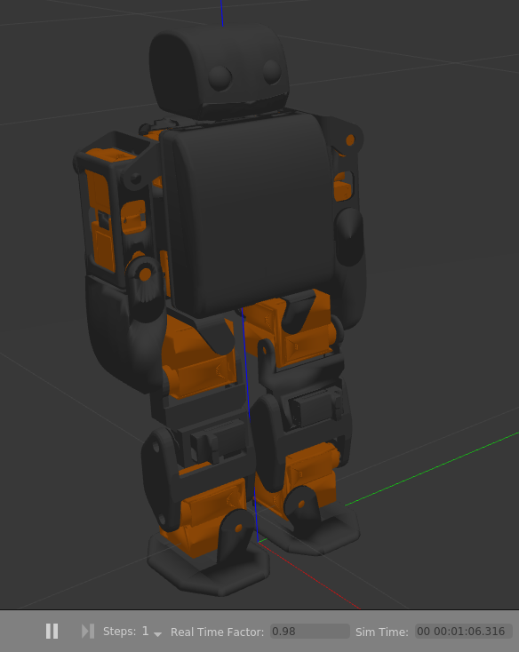
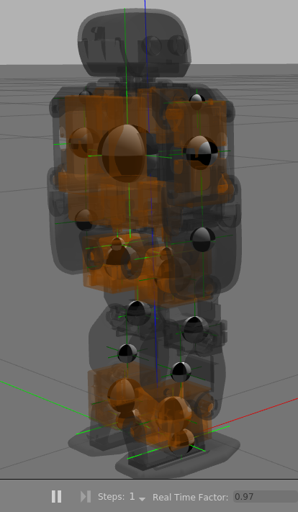
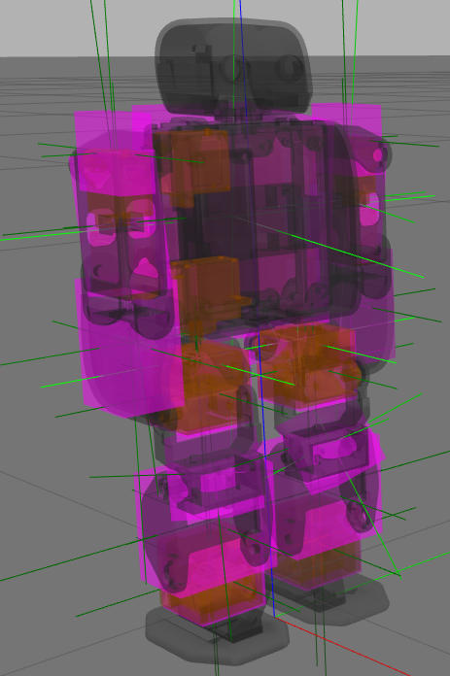
Finished URDF in Gazebo - COM, Inertia

Slide 3
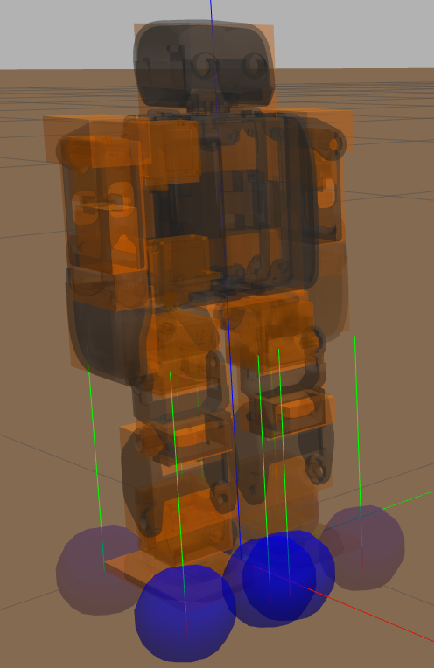
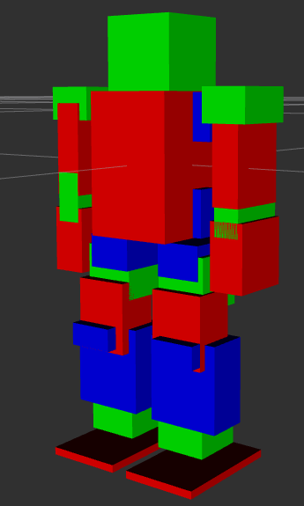
Finished URDF - Contact, Collision Boxes

Slide 4
Modified CAD, Testing custom Servo Horn...
Still messing with tolerances, forgot about PLA shrink.

Slide 5
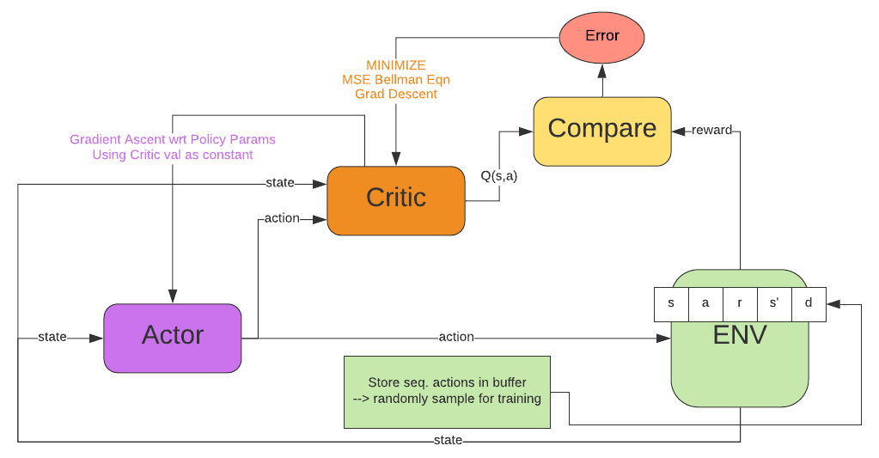
DDPG: Target Networks not shown for simplicity
lucidchart.com
UPDATE THIS FOR PROPER S,A,S’,A’,R USAGE!!!!!!!!!!!!

Slide 6

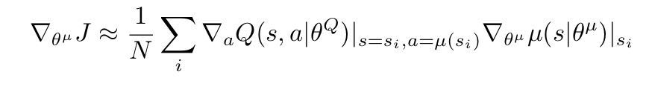
DDPG: Detail
Critic Training: minimize Mean Squared Bellman Eq. Loss using stochastic gradient descent
Target Networks updated by trailing main network using polyak averaging:
0 < p < 1
Actor Training: assume Q-fcn differentiable wrt actions, perform gradient ascent wrt policy parameters, taking Q-fcn parameters as constants. ‘i’ is an sample from the minibatch.
Target calc. using target networks
Policy gradient

Slide 7
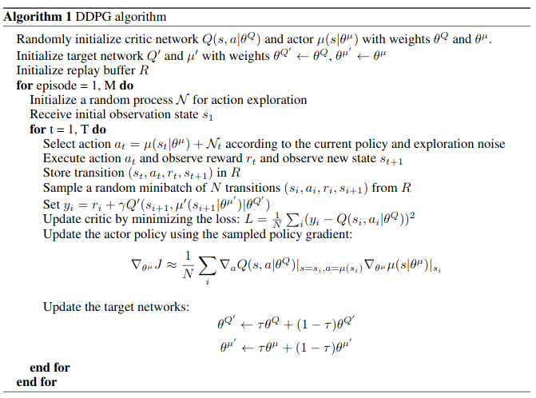
DDPG: Algorithm
Notice y_i (target) includes Q’ term, since target also approximates all future rewards - assuming policy is followed forever - discounted by gamma.

Slide 8
DDPG: Shortcomings
Overestimates Q-value Function by exploiting errors in it
Slow and luck-based
Sensitive to hyperparameter tuning
Solutions: TD3 (Twin Delayed DDPG)
Clipped Double-Q Learning: learn two Q-fcns and use min to form targets in MSBE Loss to avoid overestimating Q-fcn.
Target Policy Smoothing: add noise to target action to smooth Q fcn along changes in action and make it harder for policy to exploit Q-fcn errors and avoid overestimation.
Delayed Policy Updates: one policy update for every (two recommended) Q-fcn updates since critic needs to be trained faster as it impacts actor updates.

Slide 9

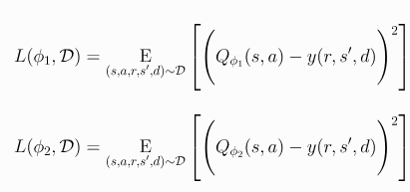

TD3: Clipped Double Q-Learning
Target calculated using min of two Q-fcns:
Both critics updated using minimum target:
Policy updated using FIRST Critic:
Avoids overestimation of Q value

Slide 10
TD3: Target Policy Smoothing + Delayed Pol Update
Add clipped mean-zero uniform noise to target action (used to form Q-learning target) and clip result to a_low <= a <= a_high:
Update policy parameters once for each Q-fcn update to encourage faster critic training.
Smooths Q fcn along similar actions and makes it harder for policy to exploit Q-fcn errors and avoids overestimation. Otherwise, Q-fcn develops false sharp peaks for some actions, which the policy will exploit erroneously.
Note action is a’(s’) since the part of the Bellman Eqn (target) it will be inserted in estimates all future rewards if policy is followed forever. In other words, we add noise to the actions which we use to estimate all future rewards to smooth the Q fcn and avoid exploiting errors.

Slide 11
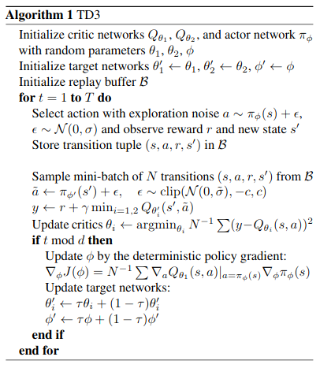
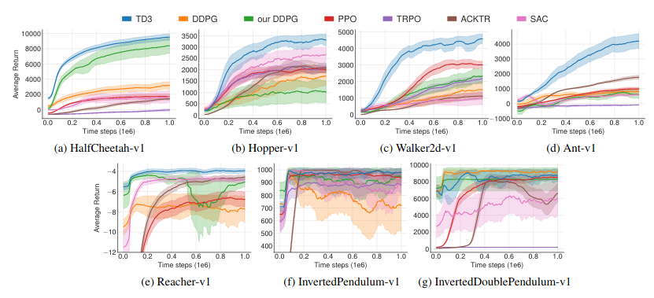
TD3: Algorithm & Results in OpenAI Gym

Slide 12
Experimenting with Bullet/Gazebo
Got Position Control in Bullet to work well, 0.3sec from give command to move, about 2.5x slower than rated motor speed (unweighted), which seems reasonable.
Looking into Gazebo ROS Control to do the same.
Bullet seems more lightweight, but has difficulty reading URDF params, and STL meshes. Also looking into setting parameters like friction/damping.
Found ROS pkg which interfaces with OpenAI Gym.
Learning curve for Gym applies to both Gazebo and Bullet, so minimal time wasted, possible reach goal to retrain in Bullet later and compare.

Slide 13
To do by next meeting:
Start Building Environment + Reward Fcn.
Start Coding Agent.
Start Assembly.
New Reach Goal: Repeat Learning in Pybullet

